Slide 1
The Landscape of USB Driver Vulnerabilities
"I though YOU were going to handle security…"

Slide 2
Topics
Razer Device Local Privilege Escalation
How Windows Selects a Driver
How Windows Downloads Drivers (and you can too)
Emulating a USB Device ID
Hands On: Programming a Digispark Kickstarter USB Device

Slide 3
The "Original" Exploit

Slide 4
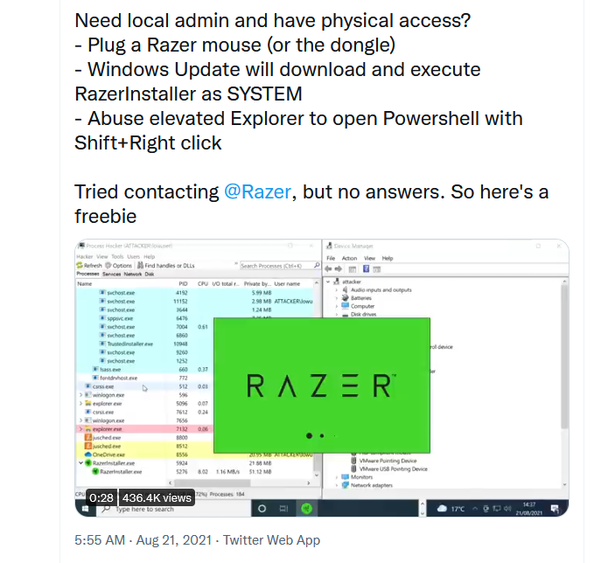
The Drop
On Aug 21, @j0nh4t dropped this tweet along with a video demo.
https://twitter.com/j0nh4t/status/1429049506021138437

Slide 5
Razer's Response
We were made aware of a situation in which our software, in a very specific use case, provides a user with broader access to their machine during the installation process.
We have investigated the issue, are currently making changes to the installation application to limit this use case, and will release an updated version shortly. The use of our software (including the installation application) does not provide unauthorized third-party access to the machine.
We are committed to ensuring the digital safety and security of all our systems and services, and should you come across any potential lapses, we encourage you to report them through our bug bounty service, Inspectiv: https://app.inspectiv.com/#/sign-up.
Probably Aug 23. Can't find press release, only quotes.

Slide 6
How does it work?
Plug in the Razer device.
Windows recognizes it as a Razer Mouse.
Windows downloads the driver package.
The driver package contains an installer executable which is automatically executed.
The installer has a "Choose Install Location" link.
Clicking the link opens a Windows Explorer window.
Navigate to, or type the path to your desired executable.
It runs as the current user, nt authority/system.

Slide 7
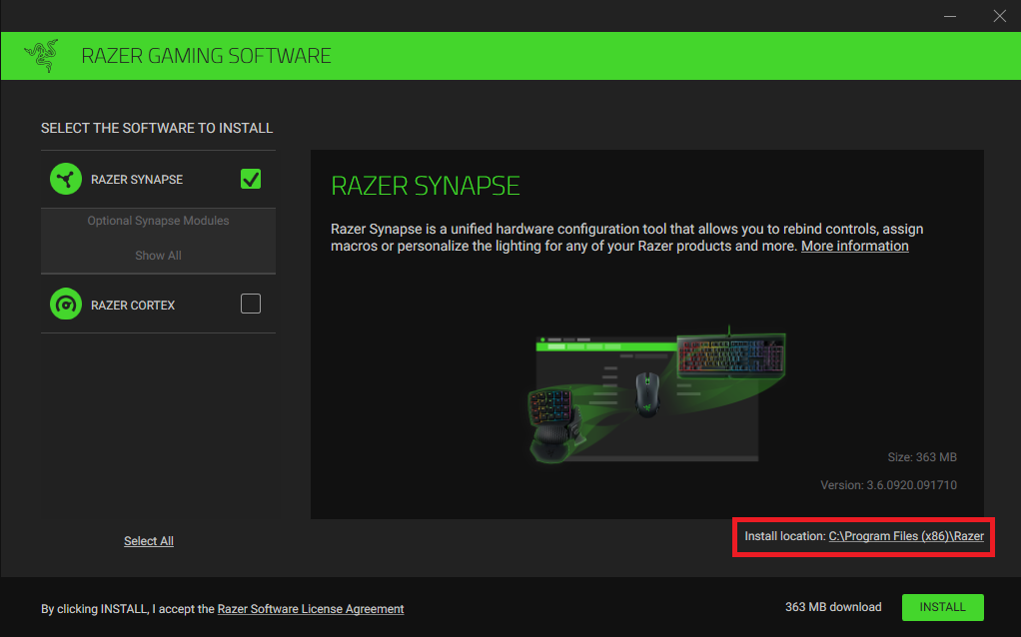
Exploit – Step 1

Slide 8
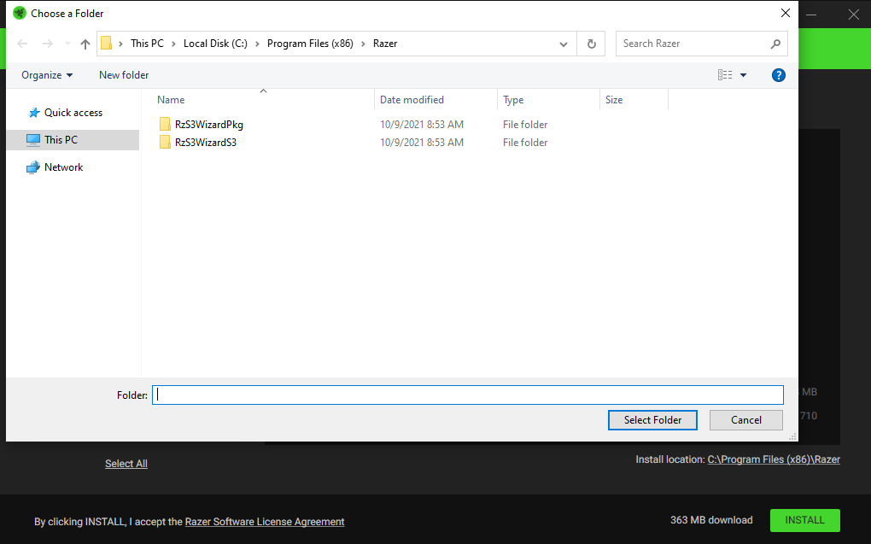
Exploit – Step 2

Slide 9
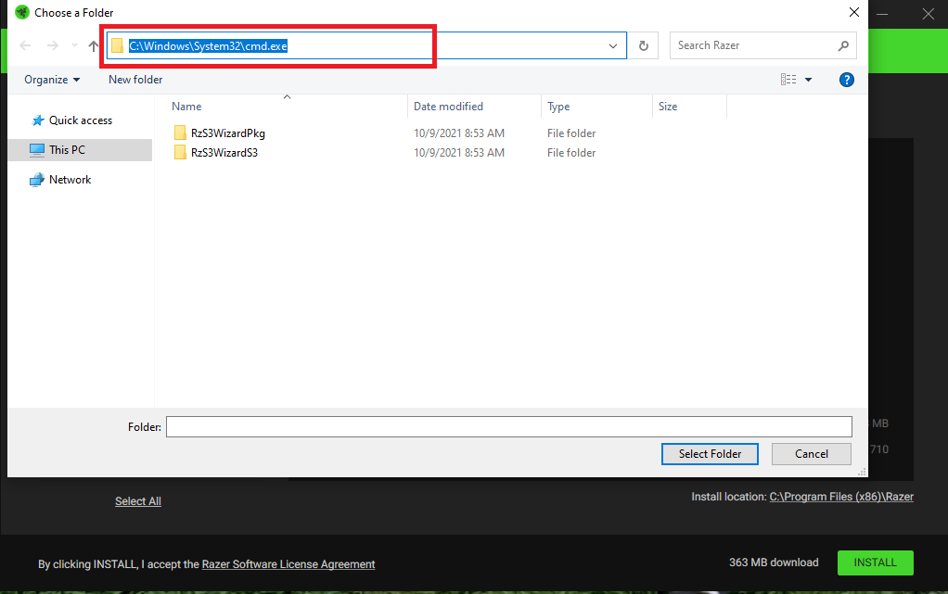
Exploit – Step 3

Slide 10
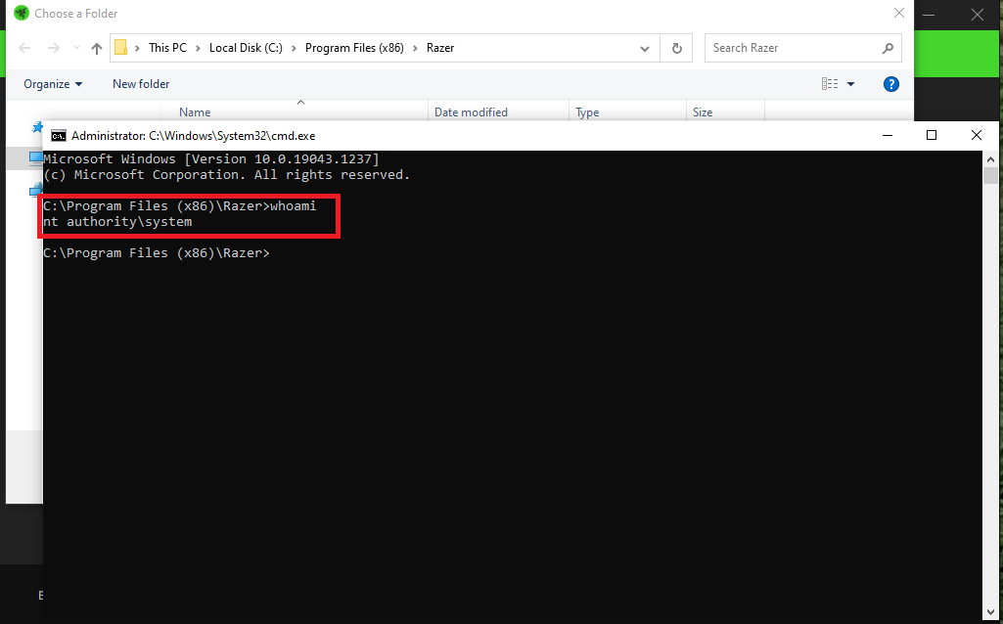
Exploit – Step 4

Slide 11
One time use?
If anyone has plugged in a similar device, the driver will be on the system, so the installer will not be executed.
But regular users can reset…
Open Device Manager
Find the device by plugging it in.
Right click –> Uninstall Device
Sometimes useful to show devices that aren't plugged in:
In Device Manager: View -> Show hidden devices
Right click on an unknown device
Click on the "Events" tab (or Properties)
USB vendor/device ID will be displayed

Slide 12
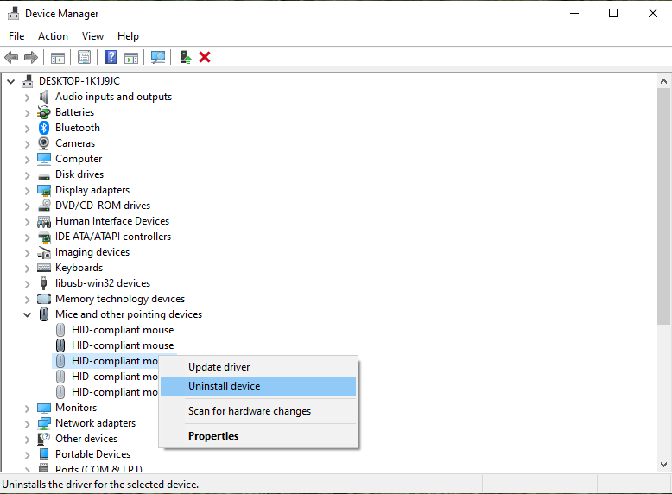
Reset – Step 1

Slide 13
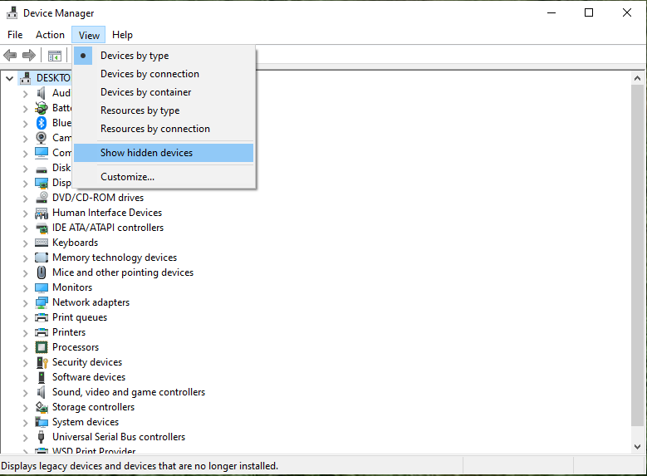
Reset – Show Devices not Present

Slide 14
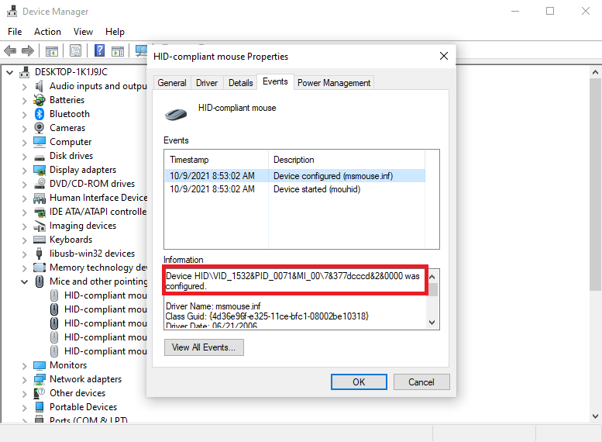
Reset – Identify Device

Slide 15
Not just Razer
SteelSeries Keyboards, etc.
https://0xsp.com/security%20research%20&%20development%20(SRD)/local-administrator-is-not-just-with-razer-it-is-possible-for-all
This site has other interesting resources (payloads, escalation paths, etc.)
Instead of changing install location, click on "Learn More" link in EULA.
Opens IE running as system.
File -> Save As -> Explorer window (one of many exploit paths).
Vendor Response
"We are aware of the issue identified and have proactively disabled the launch of the SteelSeries installer that is triggered when a new SteelSeries device is plugged in. This immediately removes the opportunity for an exploit and we are working on a software update that will address the issue permanently and be released soon."
PATCHED – August 28

Slide 16
The Blame Game
WINDOWS runs driver installers as system.
Drivers run with low level privileges on most (all?) operating systems to grant hardware access and performance benefits.
The installer "probably" has to have the ability to write to protected locations.
VENDORS bundle extra software with their driver.
Provides "enhanced user experience".
Installing with the driver is the most natural interaction.
Installation process uses built in Windows components.
WINDOWS components were not designed to prevent lateral movement.

Slide 17
The Driver Installation Process

Slide 18
Driver Installation Overview
Plug in a USB Device
The USB protocol gathers the devices vendor ID, device ID, and other information such as the number of interfaces
Windows compares that information to known device definitions (.inf files)
If no matches are found locally, the Windows Driver Store is consulted.
Assuming a match is found, the driver file is downloaded.
The installation process follows the steps defined in the .inf file. The driver file may contain supporting resources (images, executables, DLLS, etc.) as well.

Slide 19
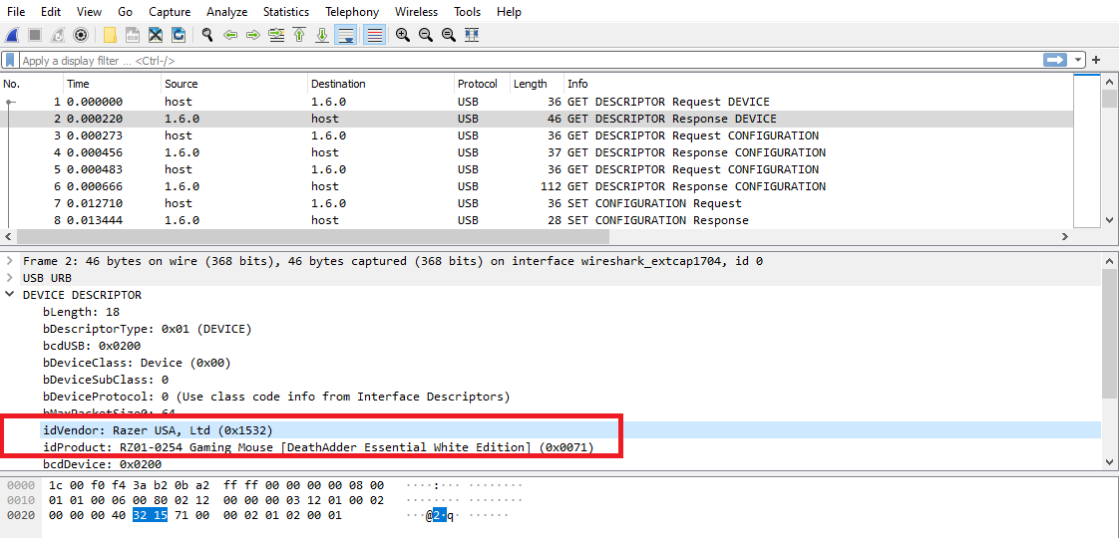
USB Device Identification

Slide 20
INF Files
VERY robust file format providing a wide array of features
USB, PCI, PCMCIA, BlueTooth, Other device identifiers
Can copy files, execute files, add registry keys, install services, etc.
More Information at: https://docs.microsoft.com/en-us/windows-hardware/drivers/install/overview-of-inf-files
Each file contains a section identifying the device it applies to.
Local library of INF files located at C:\Windows\INF
This directory is Read-Only except for Administrators, System, "Trusted Installer", and "Creator Owner"

Slide 21
INF File Example
; Copyright: (c) 2018 Razer Inc. All rights reserved
[Version]
Signature = "$WINDOWS NT$"
Class = HIDClass
ClassGuid = {745a17a0-74d3-11d0-b6fe-00a0c90f57da}
Provider = %Razer%
DriverVer=01/02/2017,6.2.9200.16503
CatalogFile = rz0070dev.cat
[DestinationDirs]
Razer_CoInstaller_CopyFiles = 11
Razer_Installer_CopyFilesWOW64 = 16426,"Razer\RzS3WizardPkg"
[Manufacturer]
%Razer%=Standard,NTAMD64
[Standard.NTAMD64]
%Razer0070.DeviceDesc%=Razer, USB\Vid_1532&Pid_0070&MI_02
[Razer.NTAMD64]
Include = input.inf
Needs = HID_Inst.NT
CopyFiles = Razer_Installer_CopyFilesWOW64

Slide 22
Windows Driver Store
If a matching driver cannot be found in local INF files, Windows will query the "Driver Store"
The Windows Catalog site provides a human interface into a similar, but not identical, repository.
https://www.catalog.update.microsoft.com/
Queries can be made on vendor name, device type, and USB string to locate drivers.
Multiple versions of the driver are available (for manual installation), but in our case, we're only interested in the latest one since that is the one that would be triggered when the device is plugged in.

Slide 23
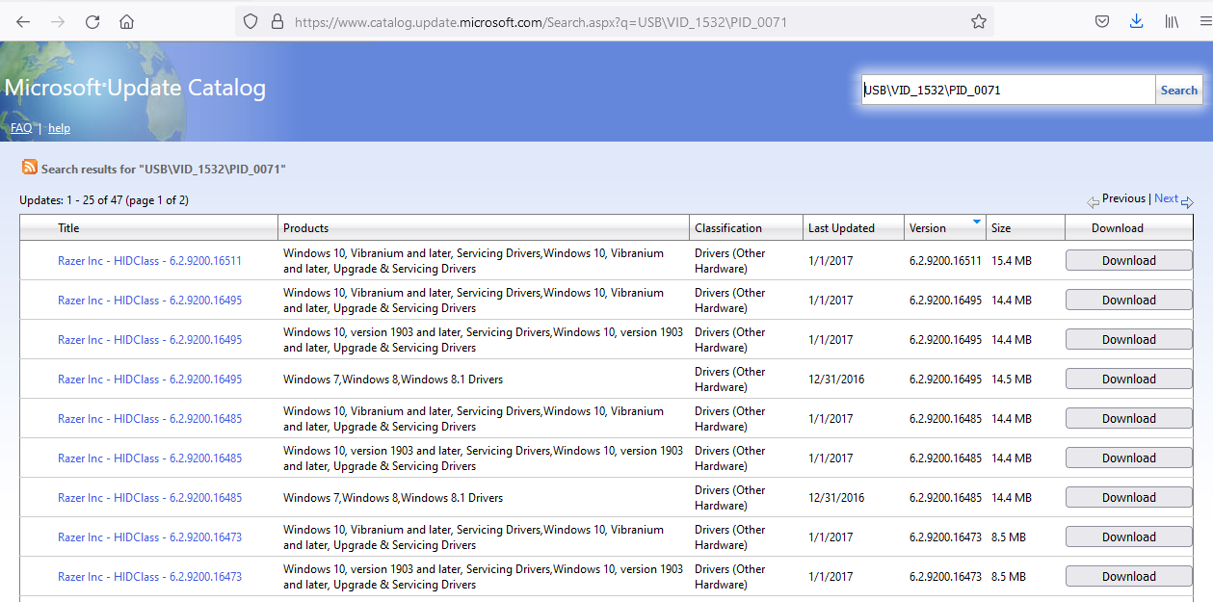
Microsoft Update Catalog

Slide 24
Unpacking the Driver
Drivers are download as cabinet (.cab) files
Cab files can be accessed using the built-in command line tool "expand".
To list the contents of a cab file
To extract the contents of a cab file to a directory
expand /d [filename].cab
expand -F:* [filename].cab [destination directory]

Slide 25
Driver Installation
Once the matching driver has been downloaded and installed, Windows will parse the .inf file and execute the steps defined.
In the case of the Razer driver, this includes running the executable bundled in the driver package named "RzS3WizardPkgS3.exe"
This is the installer that contains the vulnerable "change location" link.

Slide 26
INF File Example (Part 2)
[SourceDisksNames]
1 = %DiskId1%,,,""
[SourceDisksFiles]
RazerS3Coinstaller.dll=1,,
RzS3WizardPkgS3.exe = 1,,
[Razer.NTAMD64.CoInstallers]
AddReg = Razer_CoInstaller_AddReg
CopyFiles = Razer_CoInstaller_CopyFiles
[Razer_CoInstaller_AddReg]
HKR,,CoInstallers32,0x00010000, "RazerS3Coinstaller.dll,RazerCoinstaller"
[Razer_CoInstaller_CopyFiles]
RazerS3Coinstaller.dll
[Razer_Installer_CopyFilesWOW64]
RzS3WizardPkgS3.exe
[Strings]
Razer = "Razer Inc"
DiskId1 = "Razer Installer"
Razer.SvcDesc = "Razer Device Driver"
Razer0070.DeviceDesc = "Razer Lancehead Wireless"

Slide 27
Things that make you go hmm…

Slide 28
Are there more drivers out there with vulnerable installers?
Yes.
Not because I know of any, but the installation pattern is just too common for there not to be.
Research Path
Browsing the Windows Catalog Site
Download a driver
Unpack the driver
Look for bundled executables and / or suspicious actions in the inf file.
Emulate the appropriate device to trigger the install.
Profit?

Slide 29
Would it be possible to emulate a USB device without hardware?
It looks like it.
Windows 10 supports emulated USB devices using the Windows Driver Kit
https://docs.microsoft.com/en-us/windows-hardware/drivers/usbcon/developing-windows-drivers-for-emulated-usb-host-controllers-and-devices
https://developer.microsoft.com/en-us/windows/hardware/
The Windows Device Testing Framework is designed to support unit tests for drivers and hardware.
This might include functionality for emulation.
https://docs.microsoft.com/en-us/windows-hardware/drivers/wdtf/

Slide 30
Could drivers be abused in other ways?
Very likely.
The communication between a device and its driver would be "trusted" in the mind of a developer and very prone to "happy path" programming.
If a device could be emulated far enough to submit data to the driver, the driver's data handling processes could be attacked.
Since the driver is running as System, a buffer overflow or other remote code execution vulnerability would have the same permissions.
Drivers sometimes automatically install Services as well.
These services may accept input both from the device and from other protocols (e.g. RPC, network)
These services are likely not as well tested as a built-in Windows service

Slide 31
Could non-USB devices have similar vulnerabilities?
Yes.
The INF file format supports device identification through at least the following protocols:
USB
Bluetooth
PCI
PCMCIA
SWC – Software Component?
If there were a network/radio protocol that could trigger driver installation, it might be possible to upgrade the Privilege Escalation bug to Remote Code Execution.

Slide 32
Side Note: PrintNightmare
PrintNightmare was more of an RPC exploit than a driver exploit.
Print Spooler exposes two RPC calls that end up using the same vulnerable code: RpcAddPrinterDriverEx and RpcAsyncAddPrinterDriver
The permission check on these calls can be short circuited by sending a specific flag in the RPC request.
The behavior of the request provides primitives to copy a file to a known location and then load it as a config file.
The call is used twice. First to upload an attacker controlled DLL and then to load it into Print Spooler as a config file.
Since Print Spooler runs as system, the entry functions of the DLL will be executed with those permissions.
Good writeups at:
https://hidocohen.medium.com/understanding-printnightmare-vulnerability-cf4f1e0e506c
https://www.sygnia.co/demystifying-the-printnightmare-vulnerability

Slide 33
Side Note: EvilPrinter
An attack against the printer driver validation process.
Authenticated user triggers the installation of a printer and specifies an attacker controlled location.
The attacker serves a malicious printer driver package.
The package may contain a DLL that is not part of the signed driver content.
That DLL will be loaded as part of the install process and may contain arbitrary code.
Good writeups at:
https://media.defcon.org/DEF%20CON%2028/DEF%20CON%20Safe%20Mode%20presentations/DEF%20CON%20Safe%20Mode%20-%20Zhipeng-Huo%20and%20Chuanda-Ding%20-%20Evil%20Printer%20How%20to%20Hack%20Windows%20Machines%20with%20Printing%20Protocol.pdf
Recorded Talk – Defcon 29 – Jacob Baines – Brind your Own Print Driver Vulnerability

Slide 34
Emulating a USB Device
Method 1: Android Device

Slide 35
Pre-requisites
You must have root privileges on the Android device
Kernel MUST be built with USB ConfigFS support
Based on my experience, most are NOT
Otherwise the emulation can be configured both through Apps and via shell script.
Kali NetHunter has the capability to execute this attack if your device does.

Slide 36
USB Gadget Instructions
Download the emulation script
https://github.com/tothi/usbgadget-tool
https://raw.githubusercontent.com/tothi/usbgadget-tool/master/usbgadget-tool.sh
Load the script onto a rooted Android device in an executable directory
adb push usbgadget-tool.sh /data/local/tmp
OR wget the file to this location directly
From a root shell, run usbgadget-tool.sh
Select option 1
Plug phone into a computer

Slide 37
Emulating a USB Device
Method 2: Digispark Digistump (ATtiny85)

Slide 38
Overview
Digispark created a device (that many have cloned) to server as a USB development board using an ATtiny85 microcontroller.
A low level USB driver for this chip has existed for a while – VUSB
https://www.obdev.at/products/vusb/index.html
Digispark built Arduino IDE compatible libraries around this code.
The Digistump makes programming easy
When you first plug it in it acts as a programmable microcontroller.
After five seconds, it runs the program that has been flashed to it.
The new program can be a USB emulator and Windows will detect it as a new device.

Slide 39
Setting up the Arduino IDE
Install the latest version of the Arduino IDE and run the IDE
https://www.arduino.cc/en/software
Open Application Preferences (File -> Preferences)
In the input field named “Additional Boards Manager URLs” enter the following URL:
http://digistump.com/package_digistump_index.json
Download support for Digistump
Go to Tools -> Board -> Boards Manager
From the Type drop-down menu select "Contributed"
Find and click Digistump AVR Boards
In Tools -> Board, select Digispark (Default – 16.5mhz)
https://maker.pro/arduino/projects/how-to-build-a-rubber-ducky-usb-with-arduino-using-a-digispark-module

Slide 40
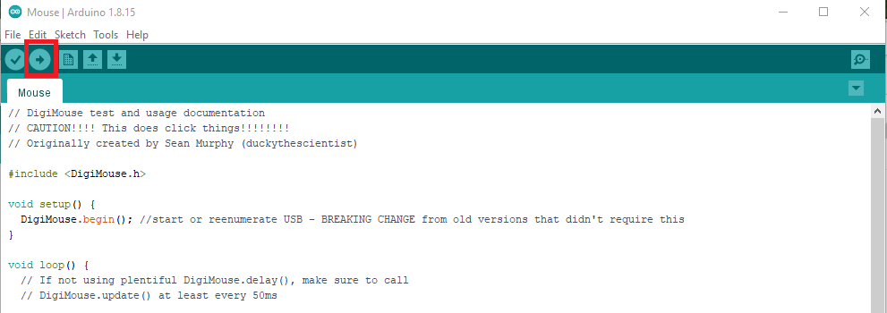
First Digistump Project
Under File -> Examples -> Examples for Digispark 16.5Mhz
Select "DigisparkMouse -> Mouse
A new project named "Mouse" should appear.
To make sure things are working click the "Upload" button, wait for compilation to complete, then plug in your Digistump.
After programming (5 seconds), you should hear the device reload and your mouse will start moving around.

Slide 41
Find the driver
V-USB provides a way to tinker with the vendor and device ID
Digispark/Arduino do not.
We're going to modify the DigiMouse code.
Locate the Digistump Mouse library code:
%localappdata%\Arduino15\packages\digistump\hardware\avr\1.6.7\libraries\DigisparkMouse
Make a backup of this director just in case.

Slide 42
Hack the Driver
Open usbconfig.h
Change the Vendor ID on line 224 to read
This is Razer's vendor ID
Note the reverse byte order. So "1532" from USB docs becomes 0x32,0x15
Change the Device ID on line 233 to read
This is the device ID for the ChromaDock
#define USB_CFG_VENDOR_ID 0x32, 0x15
#define USB_CFG_DEVICE_ID 0x21, 0x0f

Slide 43
Simplify the Sketch
We don't actually want any mouse movement so strip the code down to the following:
void setup() {
// put your setup code here, to run once:
DigiMouse.begin();
}
void loop() {
// put your main code here, to run repeatedly:
DigiMouse.delay(500);
}

Slide 44
Try it out
Press the "upload" button again.
Plug in the Digistump
Wait 5 seconds while it loads.
You should hear the device disconnect and reconnect.
Wait 20-60 seconds for the driver to download and load
You should see the Razer install screen.

